Slide 1
Credit Rating Classification
CS 513 Knowledge Discovery and Data Mining - Section A
Group 1
Harshil Cherukuri, Harshal Panpaliya, Sidharth Peri, Sufyan Shaha

Slide 2
Overview
Problem Overview
Objective and Goals
Data Description
Sub-Problem 1: Data Cleaning and Feature Importance
Main Problem: Predicting Credit Ratings
Sub-Problem 2: Clustering Bonds
Conclusion

Slide 3
Problem Overview
Global fixed income (bond) market totals about $130 trillion in outstanding debt
Bonds are denoted with a credit rating, a measurement of their overall risk as an investment by 3 different credit rating agencies (Moody’s, S&P, and Fitch)
For traders and financial market participants, predicting corporate bond ratings, forecasting rating changes, and analyzing market data to accurately make these predictions are all important
Notes:
Harshil
Leads to positioning yourself on the correct side of trades
Trading and financial firms have teams designed for this exact purpose of predicting credit ratings

Slide 4
Objective and Goals
Sub-Problem 1: Data Cleaning and Feature Importance
Goal: Systematically determine what the most important financial metrics within the dataset are for predicting credit ratings
Importance: Eliminates noise within data and provides a focused set of metrics for fundamental analysis
Main Problem: Predicting Credit Ratings
Goal: Using most important financial metrics, create models to accurately predict and classify credit ratings on unseen data
Importance: Main objective of project, if models are accurate they can be used to determine future bond ratings given forecasts of financial performance
Sub-Problem 2: Bond Clustering
Goal: Implement unsupervised learning models to see if clustering bonds leads to a grouping system aligning with credit ratings
Importance: Provides a similar predictive model for unknown credit ratings, which would be more beneficial for new issuances
Notes:
Harshil

Slide 5
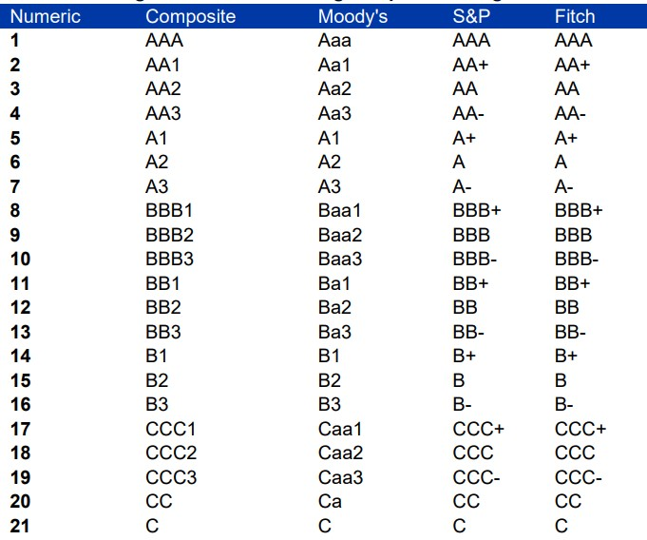
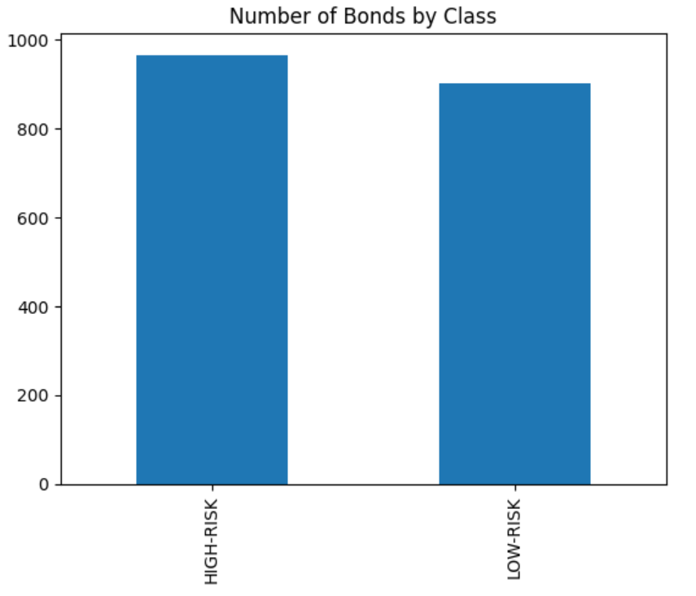
Data Description
The data is collected from Intercontinental Bond Data Index (ICE) from BoFa
Specifically using High-Yield Index data from September 1, 2023
The dependent variable, RATINGS consists of 11 different groups:
Low-Risk Credit: BB1, BB2, BB3
High-Risk Credit: B1, B2, B3, CCC1, CCC2, CCC3, CC, C
Models will predict binary classes: Low-Risk and High-Risk
Data includes 1865 unique bonds (rows) and 138 unique features (columns)
Notes:
Harshil
which tracks more than $100 trillion in global market debt
HY Ratings: BB1, BB2, BB3, B1, B2, B3, CCC1, CCC2, CCC3, CC, C
Glossary of features: https://www.ice.com/publicdocs/data/Bond_Index_Methodologies.pdf (page 73)

Slide 6
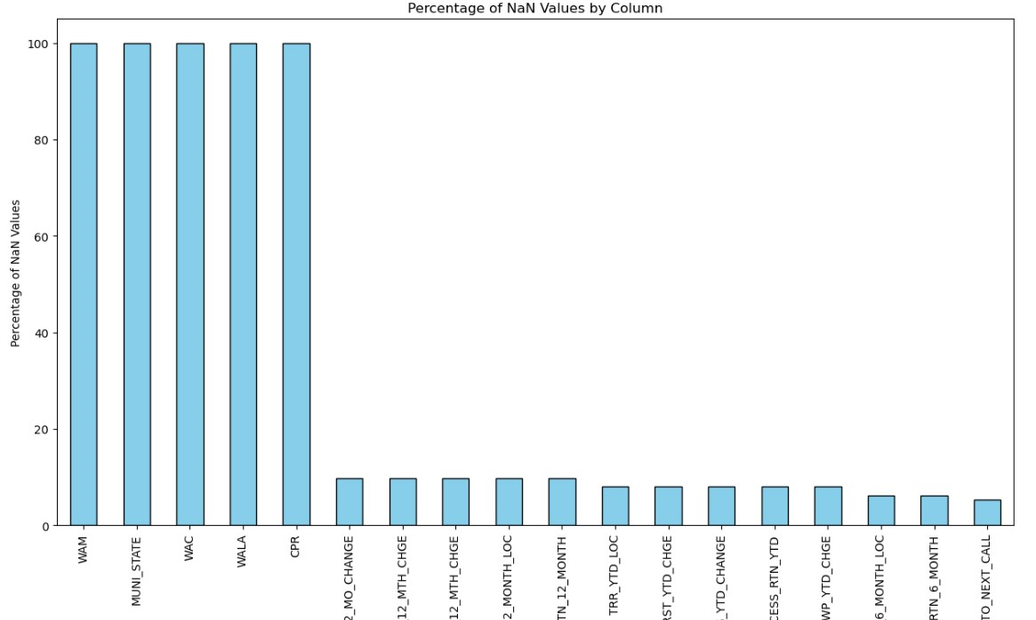
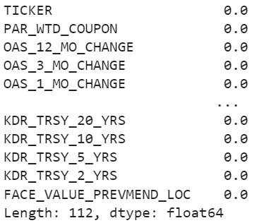
Sub-Problem 1: Data Cleaning and Feature Importance
Data Cleaning
Drop columns with 100% NaN
WAM, MUNI_STATE, WAC, WALA, CPR
Drop Constant Features
15 Total (Ex: AS_OF_DATE, INDEX_NAME, MLINDLVL1_CODE)
Drop CUSIP and ISIN_NUMBER
Drop features with duplicate information in multiple columns
DESCRIPTION and TICKER
ML_INDUSTRY_LVL_2 (3,4) and MLINDLVL2_CODE (3,4)
Interpolate Missing Values
Numerical Features: Fill with column average
Categorical Features: Fill with column mode
Notes:
Sid
(Unique identifiers for each bond)
(Same value in each row)

Slide 7
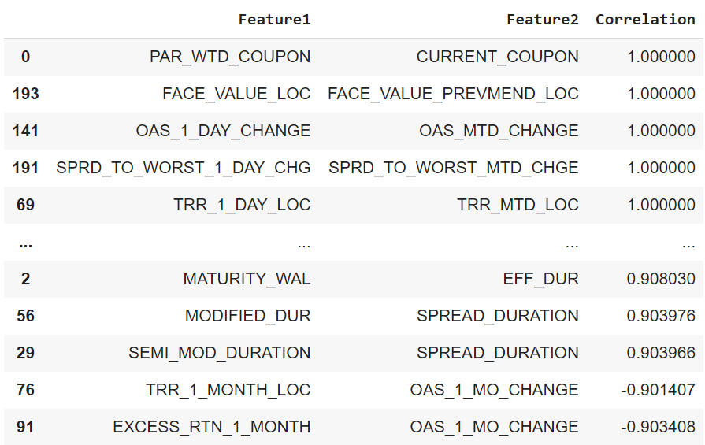
Sub-Problem 1: Data Cleaning and Feature Importance
Multicollinearity, One-Hot Encoding, Feature Scaling, Train-Test Split
Multicollinearity: Exists when multiple features exhibit high correlations (+ or -) with each other.
Solution: Pairwise correlation check
One-Hot Encoding: Method to convert categorical variables into numerical variables for model construction
Now 2415 total columns
Feature-Scaling: Min-Max Normalization
Train-Test Split: 70% Train (1305), 30% Test (560)
Notes:
Sid
Problem: Undermines the statistical significance of features and makes models harder to interpret. Typically a problem in regression, but in classification not as much affecting predictions rather negatively impacts model interpretability. Important step for extracting feature importances.
Solution: (Drop one feature from each unique pair where correlation > 0.9)
One-Hot Encoding: Constructs column for each unique categorical value and treats column as binary variable

Slide 8
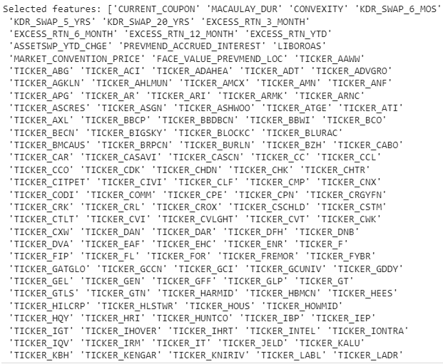
Sub-Problem 1: Data Cleaning and Feature Importance
Feature Importance Model 1: Logistic Lasso
LASSO: Least Absolute Shrinkage and Selection Operator (also known as L1 Regularization)
Goal: Help models find balance between simplicity and accuracy by adding a penalty term to a linear models
Penalty term encourages sparse solutions and forces coefficients to be 0
Cost function adds penalty term, which is tuning parameter (λ) multiplied by the sum of the absolute value of feature coefficients
Python Implementation: Determine C parameter (1/λ), fit logistic regression model specifying: penalty = ‘l1’, extract features with non-zero coefficients
Result: 2415 features -> 474 features
Notes:
Sid
which helps in feature selection in identifying irrelevant/unimportant features

Slide 9
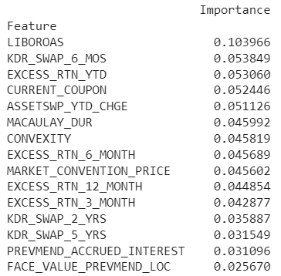
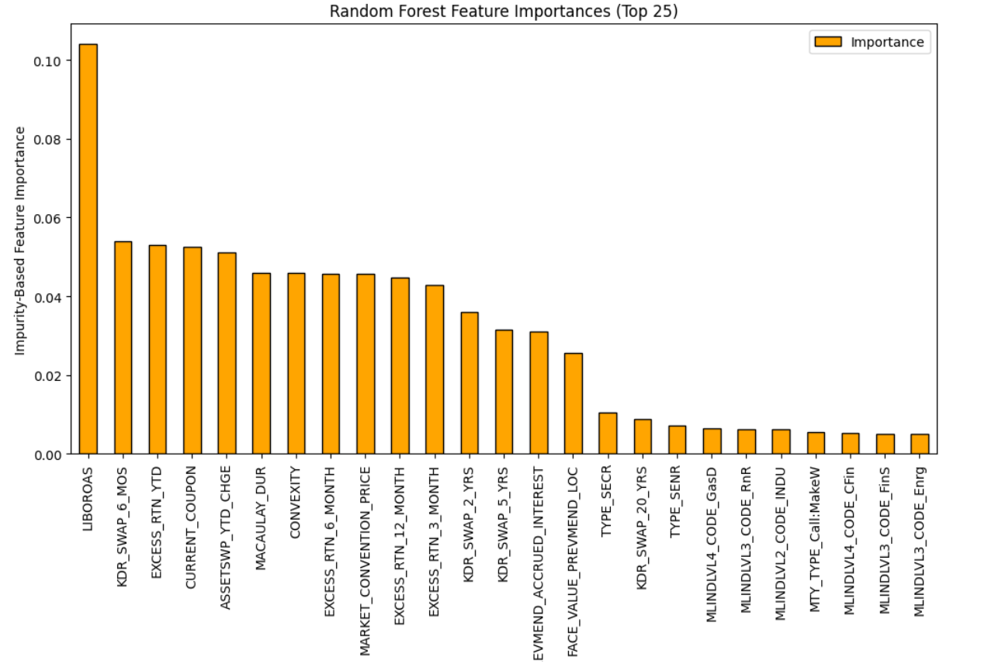
Sub-Problem 1: Data Cleaning and Feature Importance
Feature Importance Model 2: Random Forest
By fitting a random forest model, we can determine feature importances using the MDI metric (Mean Decrease in Impurity)
MDI: Calculates each importance as the sum over the number of splits (across all trees) that include the feature, proportional to the number of samples it splits
Python Implementation: Fit random forest model and obtain feature importances using built-in function
Results: 474 features -> 15 features
These 15 features are the most important features in the dataset for predicting ratings (~91% of importance of data)
Notes:
Sid
High ratio indicates feature is used in a high percentage of splits, indicating it is important for the model
All financial ratios that intuitively should be deterministic for credit ratings, ex: excess returns, coupon rate, bond yield)
Most important feature: LiborOAS - Bond’s OAS vs underlying swap curve

Slide 10
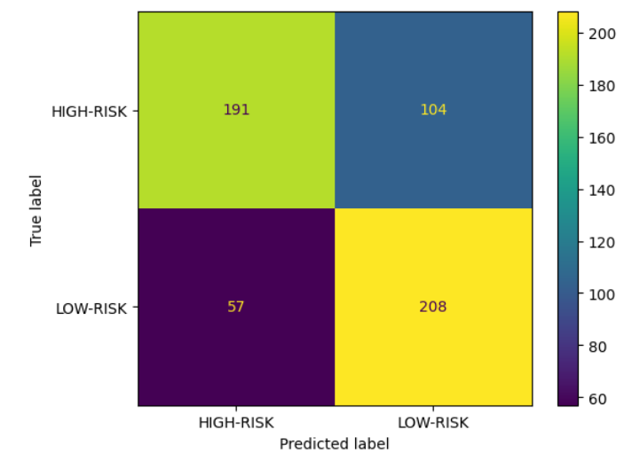
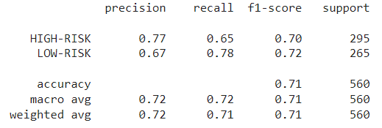
Main Problem: Predicting Credit Ratings
Model 1: K-Nearest Neighbors (KNN)
Using a grid search with cross-validation to estimate the optimal hyperparameters, we obtained the optimal hyperparameters as: k = 15, weights = distance
Accuracy: 0.7125
High-Risk predictions have higher precision and lower recall
Notes:
Harshal
Makes sense as the number of true low-risk incorrectly predicted as high risk was relatively small (opposite for low-risk predictions)
'uniform', 'distance'
Let's look at our first model, the K-Nearest Neighbors, or KNN. This model classifies credit ratings by analyzing the most common classification among a data point's closest neighbors. To determine the best approach, we used grid search to optimize the number of neighbors, which is our 'k' value, and to decide on the weighting of these neighbors. The grid search yielded a 'k' value of 15 with a distance weighting scheme.
The KNN model achieves a precision of 77% for 'HIGH-RISK' predictions but trades off with a 65% recall, while it recall 78% of 'LOW-RISK' instances but less precision.

Slide 11
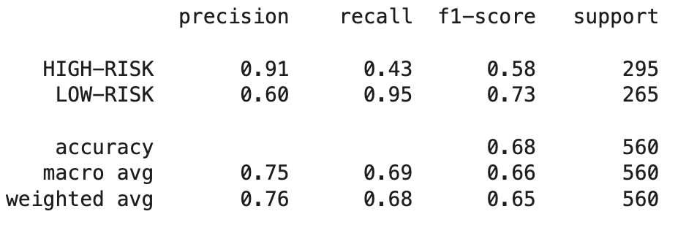
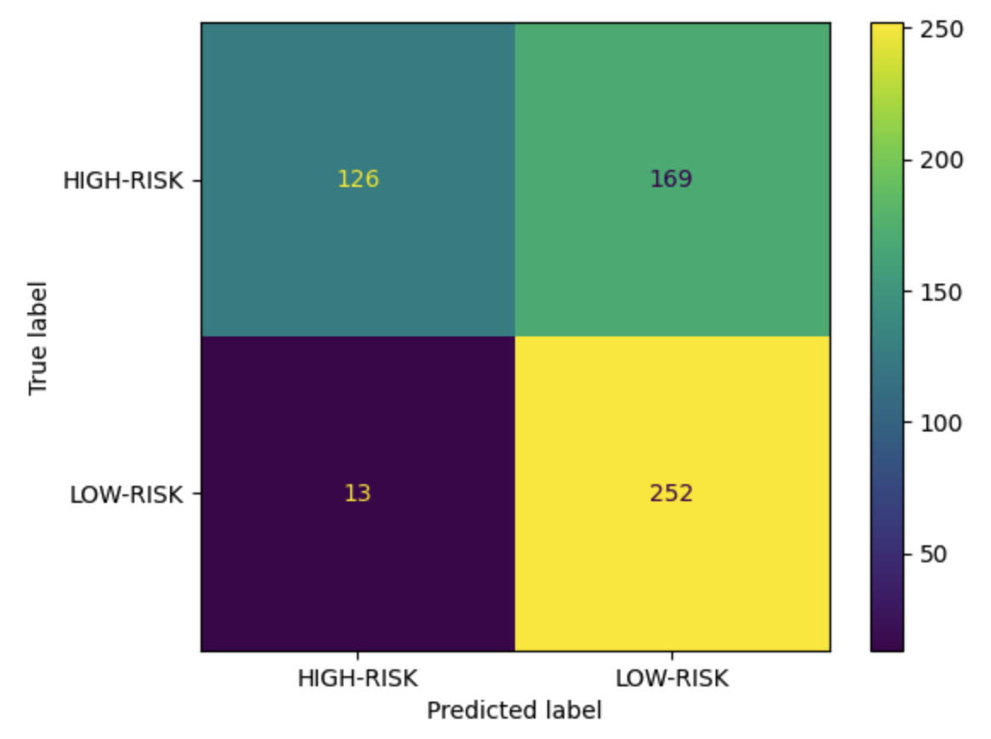
Main Problem: Predicting Credit Ratings
Model 2: Naive Bayes
The model performs well in terms of precision for both classes, especially for HIGH-RISK
The recall for HIGH-RISK is lower, indicating that the model struggles to identify all instances of this class
The F1-score for LOW-RISK (0.73) is relatively higher, indicating that it effectively identifies positive cases while minimizing false positives and false negatives
Accuracy: 0.675
Notes:
Sufyan
Our second is Naive Bayes, a probabilistic algorithm used for classification tasks and the data in each class is distributed according to a Gaussian distribution.
For high-risk instances, the precision is 0.91, implying that when the model predicts an instance as high-risk, it is correct about 91% of the time. For low-risk instances, the precision is 0.60, meaning it correctly identifies about 60% of low-risk instances but it captures more of the actual Low risk instances (95%) compared to High Risk(43%).
From the metrics, we can see that the model performs better in identifying low-risk instances compared to high-risk instances.
The accuracy of the model is pretty low and our other models give a much better result compared to this one. One reason could be that Gaussian Naive Bayes performs well, especially when the features are not highly correlated. This could mean that the data we are working with needs a model which can capture more intricacies compared to a simple Naive Bayes.

Slide 12
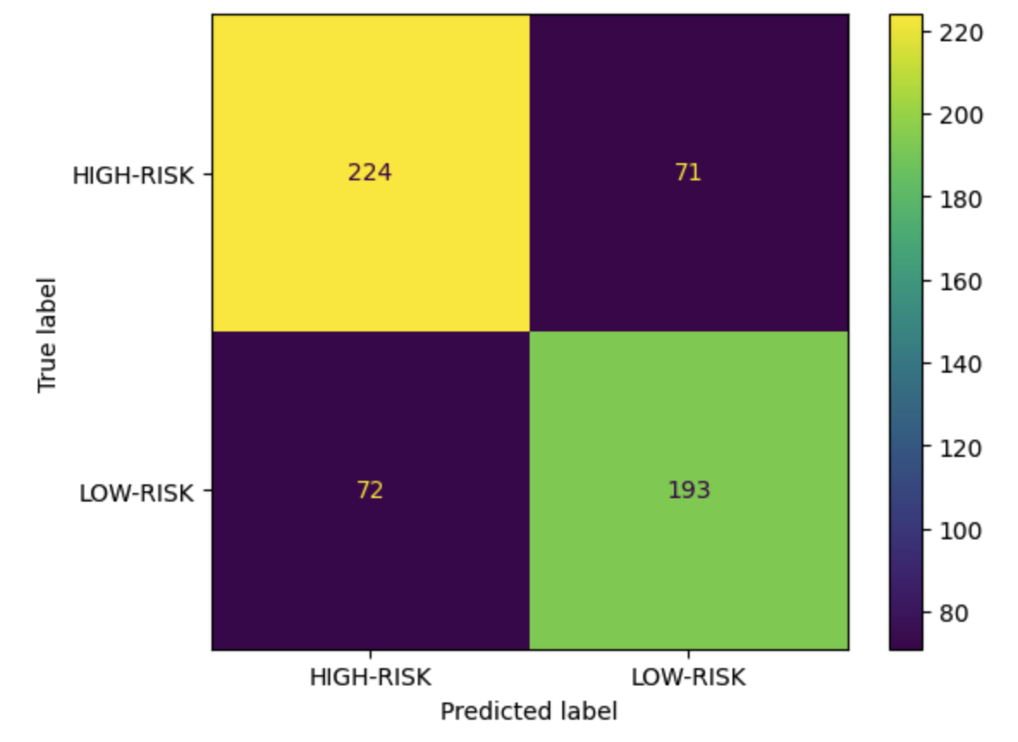
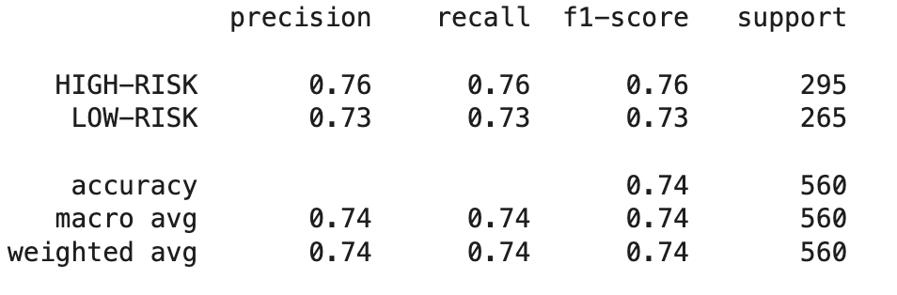
Main Problem: Predicting Credit Ratings
Model 3: CART (Decision Tree Classifier)
After hyperparameter tuning, we found that the entropy criterion was better for decision-making than gini criterion. (Entropy involves logarithmic calculations)
Accuracy: 0.744
Notes:
Harshil

Slide 13
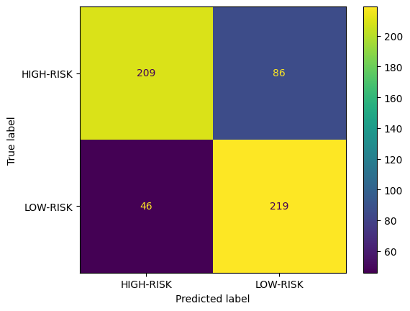
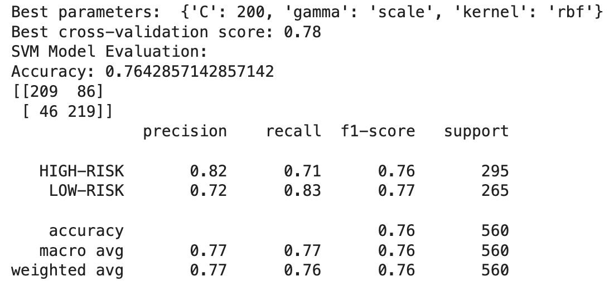
Main Problem: Predicting Credit Ratings
Model 4: SVM
Key Parameters: C: 10, gamma: scale, kernel: poly, chosen based on a grid search with a cross-validation score of 0.78.
Model Accuracy: 76.42%
The model was better at identifying true 'LOW-RISK' instances, as indicated by a higher recall value.
Notes:
Harshal
Next, we have the Support Vector Machine or SVM. This powerful model works by finding the best-separating hyperplane between different classes. Using grid search, we optimized the SVM parameters, including the regularization parameter C, the kernel type, and gamma.
And found these parameters to be the best combination.
The model showed a strong ability to identify high-risk and low-risk credit ratings, which is crucial for risk assessment in finance.
'linear', 'rbf', 'poly','sigmoid'
Support Vector Machine, or SVM, finds a hyperplane that best separates the classes by maximizing the margin between them. It’s especially powerful when the data is not linearly separable.
For our credit risk evaluation, we tuned the SVM with a polynomial kernel, achieving an accuracy of over 76%. This model is strong at identifying low-risk individuals, which is crucial for lending institutions to minimize risk.
With SVM, we’ve obtained a model that not only performs well but also provides a clear margin of confidence in its predictions, making it a reliable tool for credit rating.

Slide 14
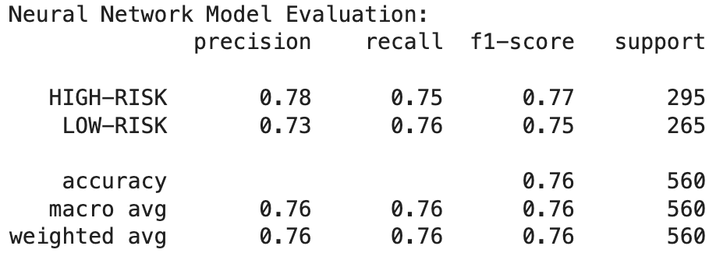
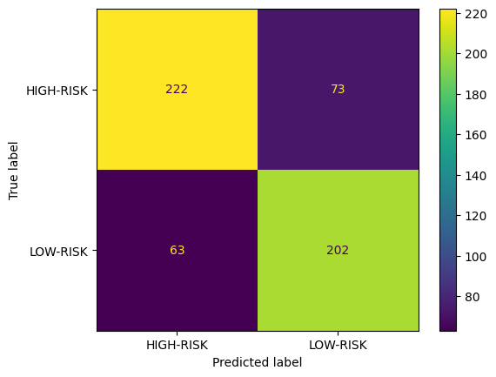
Main Problem: Predicting Credit Ratings
Model 5: Neural Network
Key Parameters: Epochs: 100, Batch Size: 32, Validation Split: 20%
Model Accuracy: 75.71%
Neural Network model is structured with an input layer, two hidden layers with dropout for regularization, and a softmax output layer.
Notes:
Harshal
Moving on to the Neural Network model. Our model is designed with two hidden layers and dropout regularization, aimed at capturing complex relationships in the data. We trained it over 100 epochs and a validation split of 20% achieving around 75% accuracy. While Neural Networks are not deterministic / stochastic in nature and can yield slightly different results upon each training, they still offer powerful predictive capabilities.
Neural Networks are akin to a web of neurons that can model complex relationships. Our network, with two hidden layers and dropout regularization, learns from the data in a deep and nuanced way.
We trained our model with a rigorous 100 epochs and achieved an accuracy of approximately 75%. While Neural Networks are not deterministic and can yield slightly different results upon each training, they still offer powerful predictive capabilities.

Slide 15
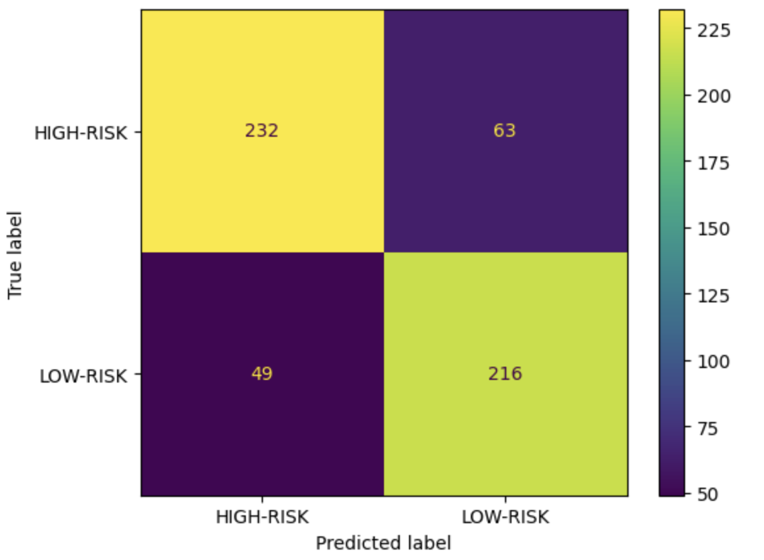
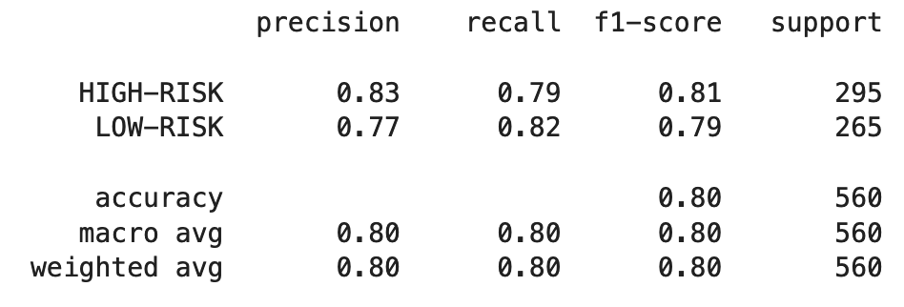
Main Problem: Predicting Credit Ratings
Model 5: Neural Network 2
Key Parameters: Epochs: 100, Batch Size: 32, with L1 and L2 Regularization l1=l2=0.001
Model Accuracy: 80.12%
With a different architecture and Regularization unlike in the previous one, the model seemed to be performing slightly better than the other one
Notes:
Sufyan
We tried another NN model, with a deeper architecture and utilized regularization. This new model performs much better compared to the previous one.
We tried three different values of Lambda (0.001,0.01and 1) during training, model performed consistently better with 0.001 and a dropout rate of 0.5 (0.3 previous one)
Possible reasons of the previous model performing slightly worse than this one could be
Overfitting - Adding regularization penalizes the loss function and thus this model avoided learning overly complex patterns and reducing the influence of less important features.
Deeper architecture - Deeper networks can capture more intricate relationships within the data, potentially improving the model's ability to learn complex patterns.

Slide 16
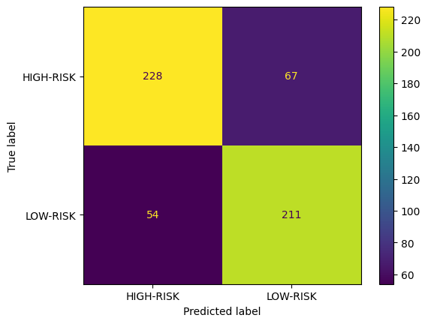
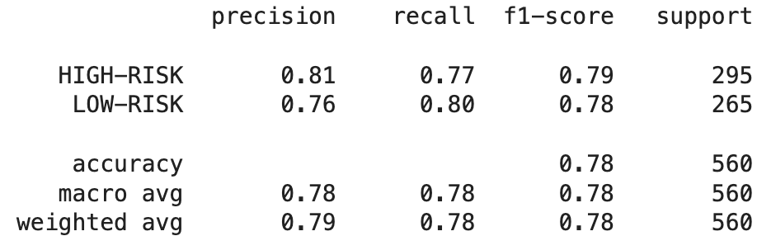
Main Problem: Predicting Credit Ratings
Model 6: XGBoost Classifier
Key Parameters: Learning rate set to 0.1, max depth at 3, and 100 estimators.
Model Accuracy: 78.39%, one of the highest among the tested models.
Balanced Classification: Equitable performance in identifying both 'HIGH-RISK' and 'LOW-RISK' categories.
Notes:
Harshal
Now, let’s focus on the XGBoost Classifier. XGBoost, which stands for Extreme Gradient Boosting, excels in managing tabular data due to its efficiency. After fine-tuning through grid search, we established optimal settings for parameters such as the learning rate, maximum depth, and the number of estimators. Our XGBoost model stands out with an accuracy of 78.4%, showcasing its reliability in credit risk classification. A key advantage over models like Neural Networks is XGBoost’s determinism, ensuring consistent results under the same conditions—a vital feature for reproducibility in financial risk assessment.
'max_depth': [3, 4, 5, 6],
'n_estimators': [50, 100, 150, 250],
'learning_rate': [0.01, 0.05, 0.1, 0.15]
XGBoost stands for Extreme Gradient Boosting. It’s a decision-tree-based ensemble that uses a gradient boosting framework and is known for its performance and speed.
Our XGBoost model achieved an accuracy of almost 78.4%, reflecting its robustness and reliable performance in classifying credit risk.
Unlike Neural Networks, XGBoost is deterministic, meaning it will produce the same results every time we run it with the same parameters and training data. This predictability is crucial in risk management.

Slide 17
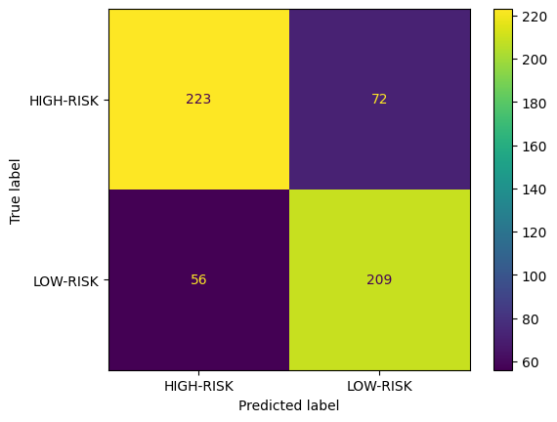
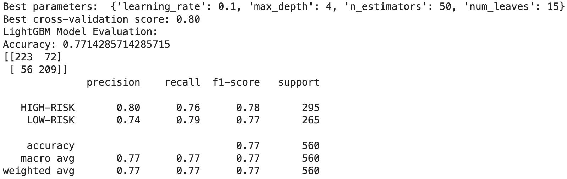
Main Problem: Predicting Credit Ratings
Model 7: LightGBM Classifier
Key Parameters: Learning rate: 0.1, Max depth: 5, n estimators: 100, Num leaves: 15
Model Accuracy: 77.14%, showcasing strong predictive capabilities.
Balanced Classification: Equitable performance in identifying both 'HIGH-RISK' and 'LOW-RISK' categories.
Notes:
Harshal
Next, we tried the LightGBM Classifier. LightGBM stands for Light Gradient Boosting Machine and is known for its speed and efficiency, especially with large datasets. We used grid search for hyperparameter tuning, focusing on the number of leaves, max depth, learning rate, and estimators.
The balanced classification capabilities of LightGBM ensure that it is adept at recognizing both high-risk and low-risk categories, making it an essential tool for financial institutions.
LightGBM is a gradient-boosting framework that builds trees leaf-wise. This method is highly efficient, leading to faster training and better accuracy.
With a learning rate of 0.1 and a depth of 5, our LightGBM model offers strong predictive performance with an accuracy of over 77%, showcasing its capacity to handle the complexities of credit rating predictions.
The balanced classification capabilities of LightGBM ensure that it is adept at recognizing both high-risk and low-risk categories, making it an essential tool for financial institutions.

Slide 18
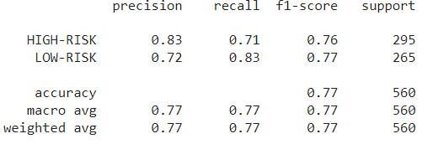
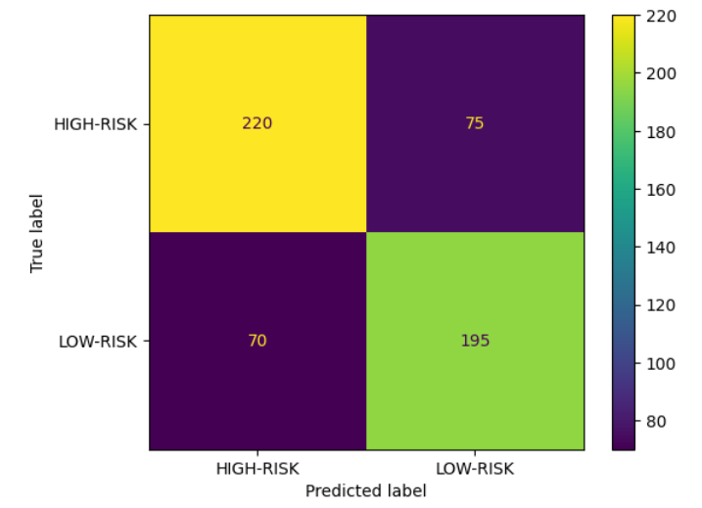
Main Problem: Predicting Credit Ratings
Model 8: Voting Classifier
Voting - Technique used to combine multiple classification models into a single ensemble model
For our implementation, we combined the KNN, Naive Bayes, CART, and SVM models shown earlier (using same hyperparameters) into a single voting classifier using hard voting
Accuracy: 0.766
Notes:
Sid
Ideal for cases where multiple well-trained models can be combined to balance out individual weaknesses to improve overall performance

Slide 19

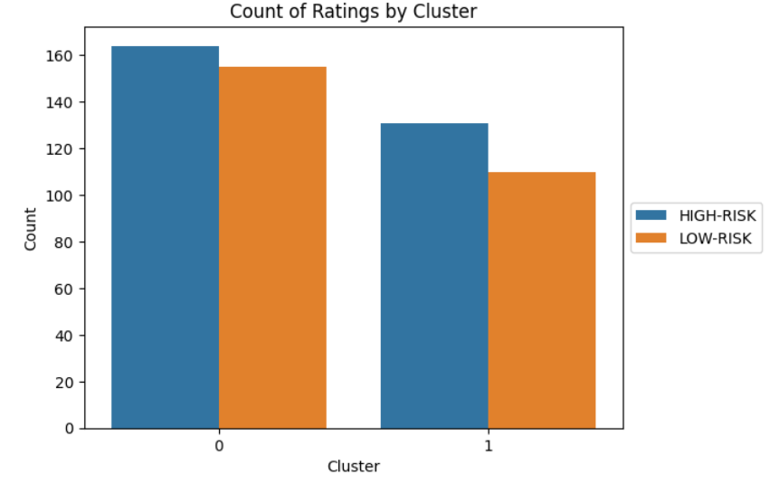
Sub-Problem 2: Clustering Bonds
Model 1: K-Means Clustering
Clusters are formed with the goal to minimize the inertia of each cluster
Each cluster centroid aims to represent the cluster as a measure of the mean of the data points assigned to each cluster
Result: Even distribution of low and high risk bonds between both clusters, does not provide divisive split we were looking for
Notes:
Sufyan
K-means clustering aims to minimize inertia between the centroids of the data cluster
Inertia - sum of squared distances of all the points within a cluster from the centroid of that cluster
We wanted to determine if this clustering methodology results in a set of 2 clusters that are highly correlated with the split of Low and High Risk
Using K means, we can see the model fails to separate the data points as intended, possible reasons could be the model failing to capture enough information from the data due to the influence of less important features.

Slide 20

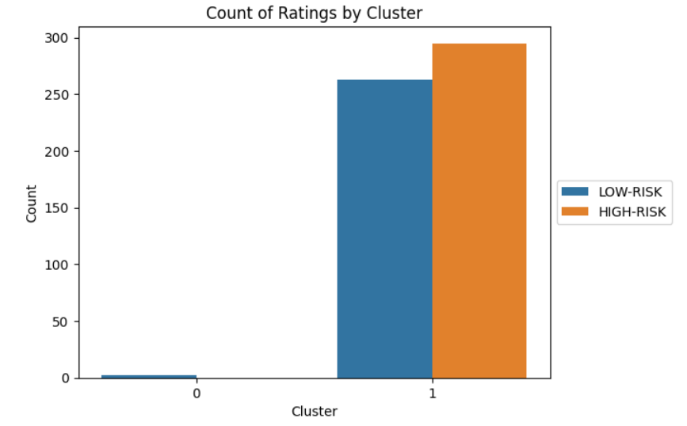
Sub-Problem 2: Clustering Bonds
Model 2: Hierarchical Clustering
Using single linkage, the clusters are formed by initially having each data point represent its own cluster and continuously merging based on minimum distance until 2 clusters are formed
Result: Heavily skewed distribution to one cluster, showing high probability of outliers in the data considering we are using single linkage
Notes:
Sufayan
We wanted to determine if this clustering methodology results in a set of 2 clusters that are highly correlated with the split of Low and High Risk
Agglomerative (bottom up approach) at each step combining two clusters that contain the closest pair of elements not yet belonging to the same cluster as each other

Slide 21
Conclusion
Sub-Problem 1: Data Cleaning and Feature Importance
Logistic LASSO and Random Forest feature importance methods in combination can help extract most important features
Financial metrics are most important to consider, particularly: LIBOROAS, KDR_SWAP_6_MOS, and EXCESS_RTN_YTD
Main Problem: Predicting Credit Ratings
Models ranging from basic to more advanced can all fairly accurately classify bonds as high and low risk according to rating
Advanced models despite not being as interpretable perform better than more basic models
Combining basic models into a single ensemble classifier yields as good results as advanced models
Sub-Problem 2: Clustering Bonds
Hierarchical and K-Means clustering are not able to cluster bonds in alignment with rating riskiness
Potentially due to outliers in data and other factors outside dataset affecting ratings
Notes:
Harshil

